Slide 1

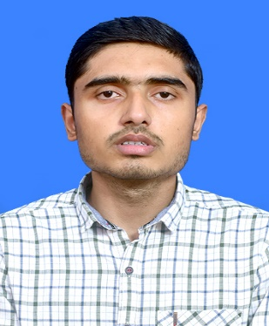



Aditya Kumar Jha
Education and certificates
Bachelor of Technology Mechanical Engineering: 2018 - 2022
Senior Analyst/Software Engineer
Technical Skills
Java
Python
Machine learning
Base Location: Bangalore
Email ID:
aditya-kumar.a.jha@capgemini.com
_{Mobile No:} +91 6378653147
Grade:
A5
Integration Tools
Webmethods
Dell Boomi
Database
SQL
Add-ons
GitHub
Data Analytics
Strengths
Has working knowledge on Webmethods Integration platform.
Ready to learn new technologies/Frameworks and implement them to further improve my knowledge.
Passionate about implementing and launching new projects.
A team player with good communication skill always ready to work for the enrichment of knowledge.
Having Knowledge on Data Structure and Algorithm and object-oriented programming.
Achievements
A machine learning unsupervised model for detecting the sleep quality.
Trained in Integration foundations with Dell Boomi.
Certified Dell Boomi Associate integration Developer.
Certified Dell Boomi Professional Integration Developer.
Project-
Currently deployed in Webmethods operations team for GE Aerospace.
Additional Details
Good Communication Skills
Team Player
Presentation Title | Author | Date © Capgemini 2017. All rights reserved | 1

